Slide 1

WELCOME
TO
SMARTINTERNZ

Slide 2
Unveiling Market Insights :Analysis Spending and Identifying Opportunities for Growth
III B SC MATHEMATICS
TEAM CANDIDATE MEMBERS : 1) DEVA M 2) ANBARASAN 3) CHANDRU 4) DHINAKARAN
UNDER THE GUIDENCE OF
B.ANITHA,M.SC.,M.PHIL.,B.ED.,SET
Guest Lecture UG and PG &Department of Mathematics
MUTHURANGAM GOVERNMENT ARTS COLLEGE VELLORE -632002

Slide 3
CONTENT OF THE THESIS
INTRODUCTION
PROBLEM DEFINIYION &DESING THINKING
RESULT
ADVANTAGES &DISADVANTAGES
APPLICATIONS
CONCLUTION
FUTURE SCOPE
APPENDIX

Slide 4
INTRODUCTION
1.1 OVERVIEW
Data Collection: To begin, you'll need access to relevant data sources. This data can come from various channels, including customer surveys, transaction records, social media, market research, and external databases. The data should cover various aspects of spending behavior, such as frequency, amount, preferences, and demographics.
Segmentation: Group your customer data into segments. This could be based on demographics, psychographics, geographic location, or any other relevant criteria. Segmentation helps you understand the diverse needs and behaviors of different customer groups.
Data Analysis: Use statistical and analytical tools to process and analyze the data. Look for patterns, trends, and correlations in customer spending behavior. Common analysis methods include regression analysis, clustering, and trend analysis.
Identify Key Metrics: Determine the key performance indicators (KPIs) that are most relevant to your business and market. This might include metrics like customer acquisition cost (CAC), customer lifetime value (CLV), conversion rates, churn rates, and average

Slide 5
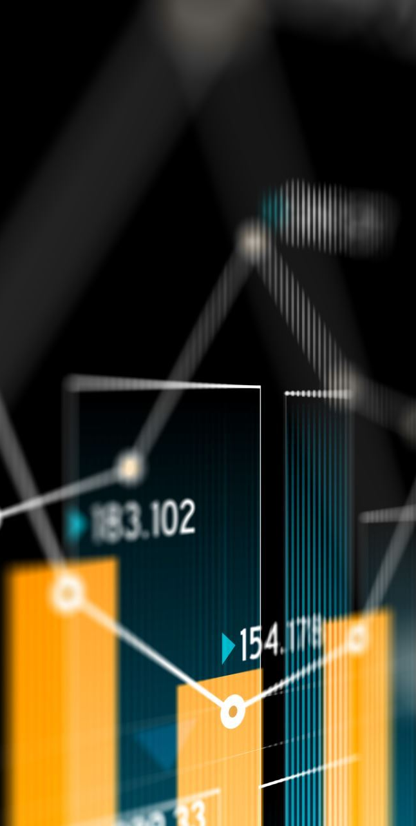
1.2 PURPOSE
Understanding market insights can help identify untapped or emerging opportunities in the market, enabling businesses to expand their offerings or enter new markets Insights into consumer behavior can help companies allocate their resources more efficiently by focusing on areas with the highest growth potential.
By understanding what drives spending behavior, companies can engage with customers more effectively, providing products and services that meet their needs.

Slide 6
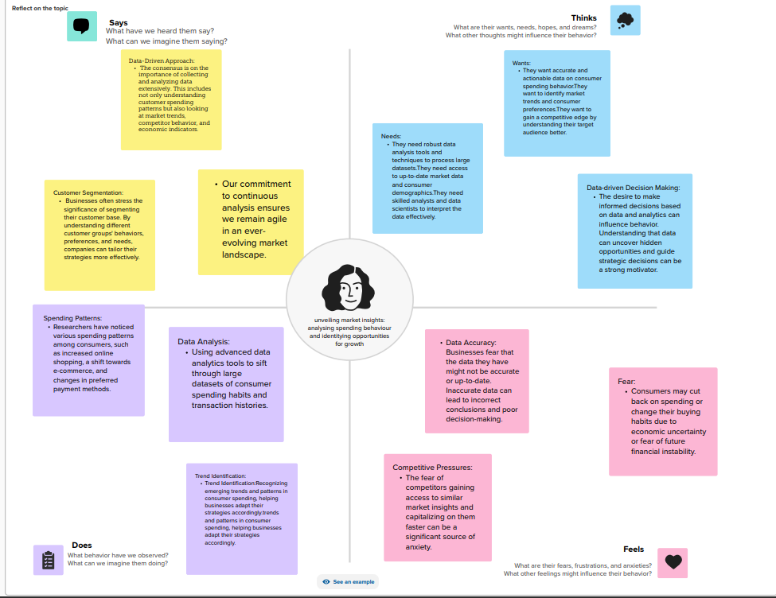
PROBLEN DEFINITION &DESIGN THINKING
2.1 EMPATHY MAP

Slide 7
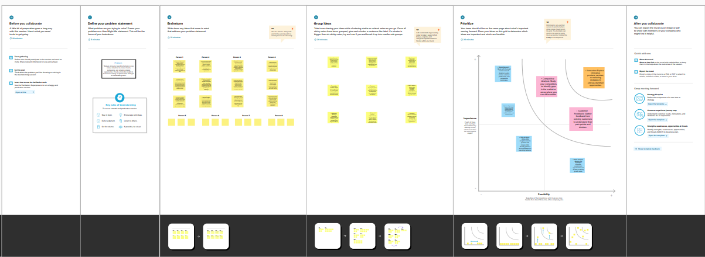
2.2 IDEATION &BRAINSTORMING MAP

Slide 8
ADVANTAGES &DISADVANTAGES
ADVANTAGES TO UNVEILING MARKET INSIGHTS FOR GROWTH
Data-Driven Decision Making
Targeted Marketing
Customer Segmentation
Product Development
Optimized Pricing
DISADVANTAGES TO UNEILING MARKET INSIGHTS FOR GROWTH
Incomplete Data:
Data Privacy Concerns:
Limited Historical Context:
Competitive Challenges:
Cultural and Geographical Variability

Slide 9
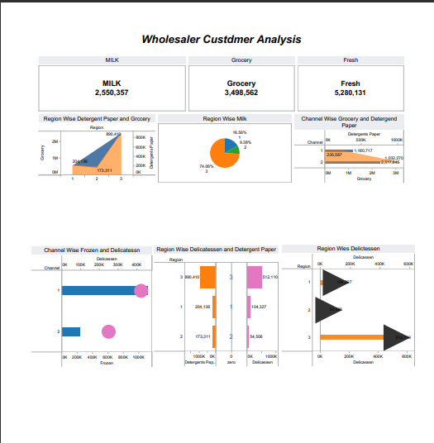
DASHBOARD
RESULT

Slide 10
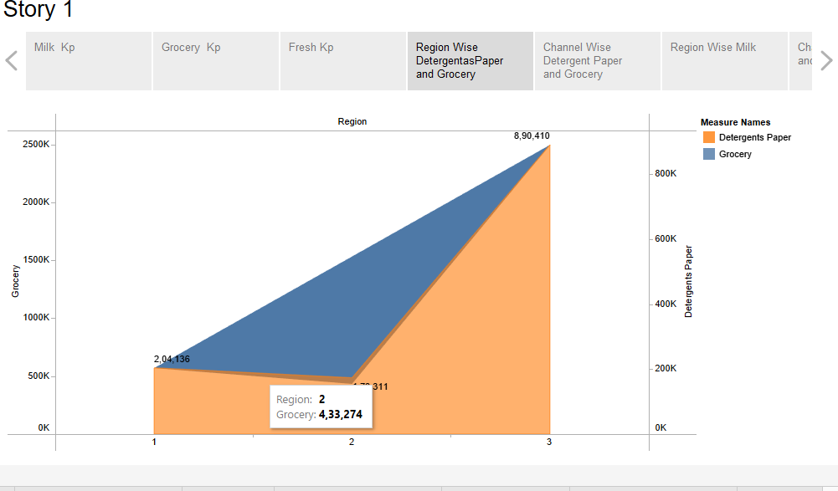
STORY 1.1

Slide 11
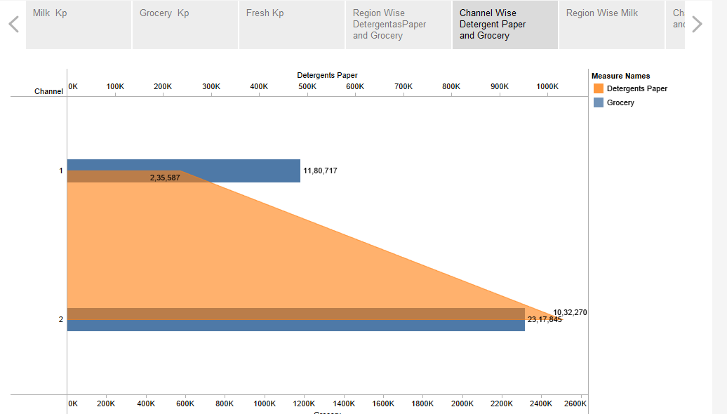
STORY 1.2

Slide 12
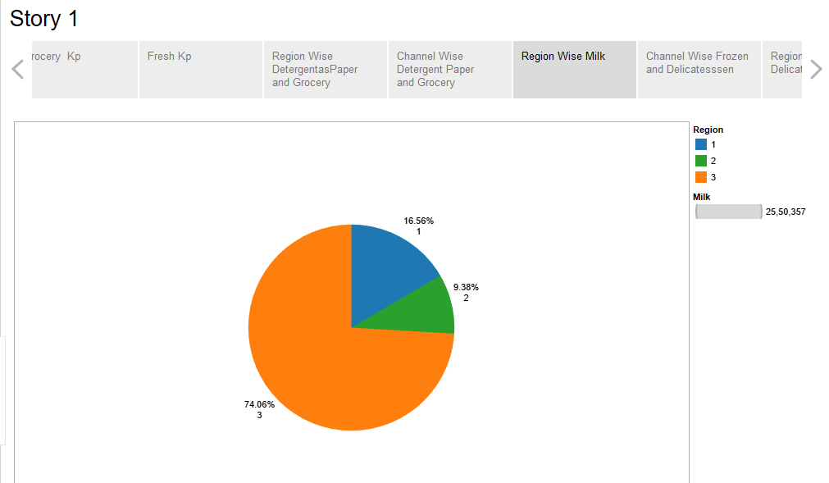
STORY 1.3

Slide 13
APPLICATIONS
Customer Segmentation: By analyzing spending behavior, businesses can identify different customer segments based on their preferences, purchasing power, and buying habits. This segmentation allows for targeted marketing and product development.
Understanding how consumers spend can help businesses fine-tune their products and services to meet the needs and desires of their target audience. It can also help identify gaps in the market that can be filled with new offerings.
Analyzing spending behavior can provide insights into what price points consumers are willing to pay for products or services. This data can inform pricing strategies, discounts, and promotions.
Market Entry: For companies looking to expand into new markets, analyzing spending behavior can help assess the market's readiness for their offerings. It can also guide decisions regarding market entry strategies and potential competitors.

Slide 14
CONCLUSION
Consumer Insights are Invaluable: Understanding consumer preferences, motivations, and behaviors is essential for any business. It enables companies to tailor their products, services, and marketing strategies to meet the evolving demands of their target audience.
Data-Driven Decision Making: The power of data in shaping business strategies cannot be overstated. By leveraging advanced analytics, businesses can gain deep insights into spending patterns, allowing for more informed decision-making and resource allocation.
Segmentation is Key: Not all customers are the same, and effective segmentation is crucial. By categorizing customers into distinct groups based on their behavior, needs, and demographics, businesses can deliver personalized experiences and offerings.

Slide 15
FUTURE SCOPE
Data Analytics and AI: The role of data analytics and artificial intelligence will continue to grow in this field. As technology improves, companies will have access to more sophisticated tools for collecting, processing, and analyzing consumer data. Machine learning algorithms will become increasingly adept at identifying spending patterns and predicting consumer behavior.
Personalization: Consumer expectations for personalized experiences will continue to rise. Businesses that can leverage spending behavior insights to tailor their products and services to individual preferences will have a competitive advantage. This extends to marketing strategies, product recommendations, and pricing models.

Slide 16
Thank you

